Slide 1
Contrasts
Howell: Chapter 12
Other books…
Last modified: 11/2/04

Slide 2
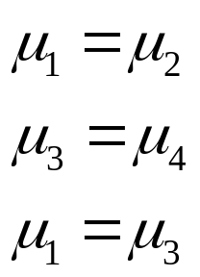
Multiple comparisons
Suppose we want to make the following comparisons:
Suppose that each test uses an α level of .05
  Error rate per comparison: .05
How likely is it that we will obtain at least one significant result in our study?
  How probable is it that we will make at least one Type I error?

Slide 3
Familywise error rate
This probability is the familywise error rate
P(at least one Type I error) = 1 – P(no Type I errors)
= 1 – (1 – α) x (1 – α) x … x (1 – α) = 1 – (1 – α)^{C}
Many multiple comparisons procedures attempt to control the familywise error rate
C

Slide 4
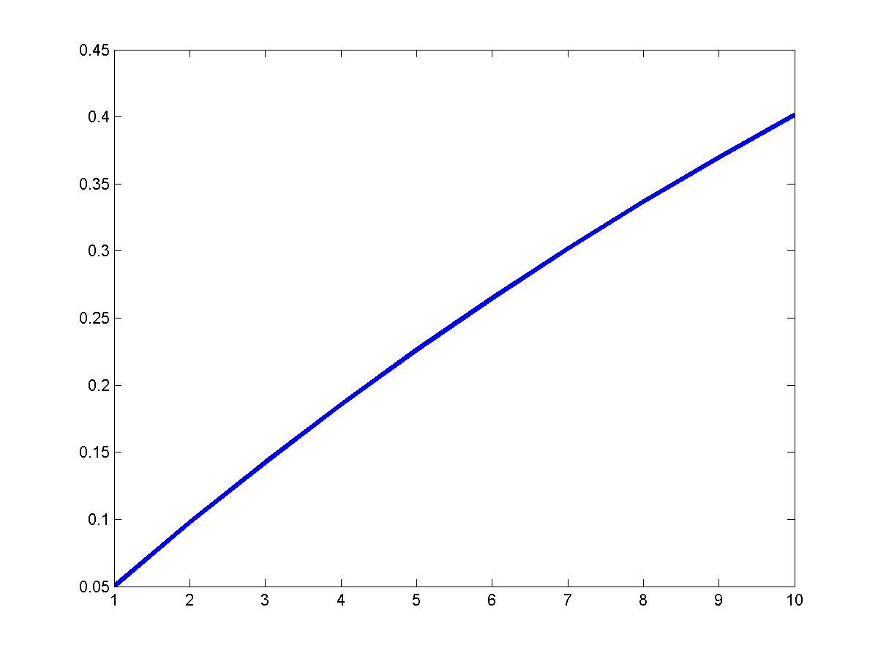
Familywise error rate
When α is the typical value of 0.05, the familywise error rate will grow as follows
error rate
# comparisons

Slide 5

Null hypothesis
In ANOVA, the null hypothesis is
Rarely are we really interested in the “complete” null hypothesis
Sometimes, we might be interested in testing a few hypotheses
Sometimes we end up testing all pairwise means
  a(a – 1)/2 comparisons

Slide 6
Contrast types
Planned contrast: contrast that the experimenter decided to test prior to any examination of the data
Post hoc contrast: contrast that the experimenter decided to test only after having observed some or all of the data
  Post hoc contrast is said to be suggested by the data
Why is the distinction between the two types of contrast important?

Slide 7
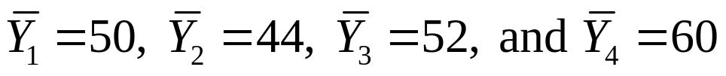
Example
Suppose that we obtain the following means:
Consider the contrast μ₂ – μ₄ when all the population means are equal: μ₁ = μ₂ = μ₃ = μ₄
If comparison of groups 2 and 4 was planned and α = 0.05 is used, 5 out of every 100 times the experiment would be conducted, the contrast would be statistically significant
  Type I error

Slide 8
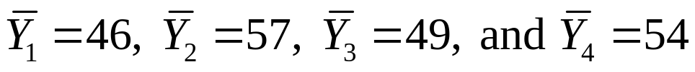
Example
If this contrast had not been planned, how would things change?
Suppose the experiment were repeated with
These results suggest that groups 1 and 2 be compared as they have the largest difference
  Usual goal of hypothesis testing is to “obtain” statistically significant result

Slide 9
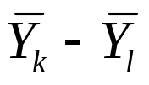
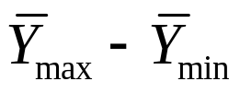
Example
The result would be that the probability of committing a Type I error would greatly exceed 0.05
The sampling distribution of is very different from where Y_{max} and Y_{min} are associated with the largest and smallest sample means
The critical value of the F distribution that provides an α level of .05 for is too small for judging the significance of
It matters greatly whether a contrast is planned or is selected post hoc

Slide 10
Significance of F
Without a significant group effect, individual comparisons are considered inappropriate by some
In fact, error rates of some multiple comparison tests require overall significance
  Fisher’s least significance difference test
But, the logic of most post hoc tests does not require overall significance before making specific comp.
Note that the overall F distributes differences among groups
  Dilutes the F when several group means are equal to each other but different from some other mean

Slide 11
Significance of F
In fact, an F test may be thought of as the average pairwise t² (in the case of equal n’s and equal variances)
In general, requiring overall significance will actually change the familywise error rate, making the multiple-comparison tests conservative
  Significance levels were established without regard for F
Wilcox: “there seems to be little reason for applying the F test at all”
But this is not the traditional view…

Slide 12

Multiple planned comparisons
Bonferroni inequality
Remember that
Such that
Thus, by setting α = .05/C

Slide 13
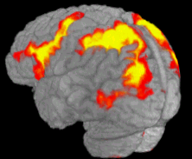
Bonferroni’s method
Bonferroni’s method: set α = α’/C, where α’ is the level adopted for a single test
Example: imaging: 50,000 to 100,000 comparisons
R
ITG

Slide 14
Bonferoni’s method
Bonferroni’s method precisely controls for the probability of a Type I error for the experiment
  Widely used, not only in the context of ANOVA
Cost: As the number of tests increases, it becomes more difficult to detect an individual true effect
  Each individual hypothesis is tested at the α’/C level
Some have argued that this puts each hypothesis test at an unfair disadvantage

Slide 15
Post-hoc comparisons
Suppose a researcher is interested in the following comparisons: μ₁ vs. μ₂, μ₂ vs. μ₃, and μ₃ vs. μ₄
As long as these comparisons have been made a priori, α for the entire experiment can be maintained at .05 by using a level of .05/3
This is the case even though there are a total of 6 pairs [4(4 – 1)/2], as long as the other comparisons are ignored!
Looking at the data and changing one’s mind is equivalent to doing all of the comparisons and adopting an improper familywise α

Slide 16
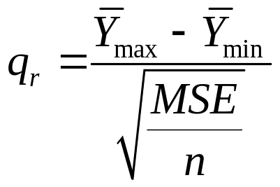


Studentized range statistic
In general, when the number of comparisons C is a(a – 1)/2, the Bonferroni approach is usually not as powerful as other special-purpose techniques that have been developed specifically for pairwise comparisons
Many post hoc tests employ the Studentized range statistic
Where and are the largest and smallest sample means

Slide 17
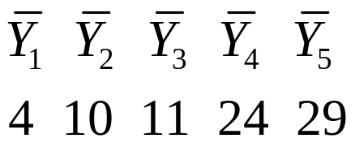
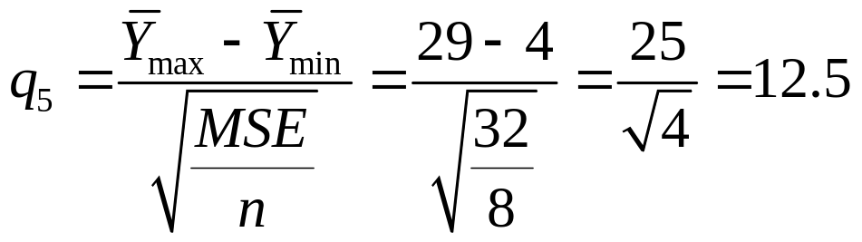
Example
To use q, we first rank the means from smallest to largest
Suppose also that n = 8, df_{error} = 35, and MSE = 32

Slide 18
Example
In general, tables for q exist that take into account the number of steps of the means
In the present case: q_{0.05}(5,df_{error}= 35) = 4.07
Since q₅=12.5 > 4.07, we reject the null hypothesis and conclude that there is a significant difference between the largest and smallest means

Slide 19
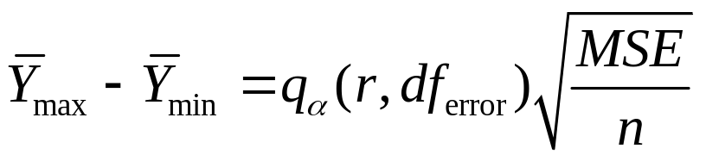
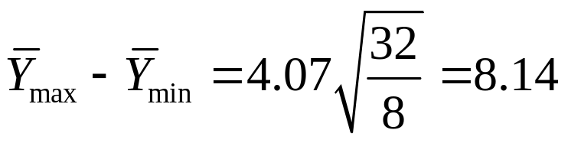
Example
It is useful to solve for the smallest difference that would be significant and compare with actual difference
In the present case
A difference in means equal to or greater than 8.14 would be deemed significant

Slide 20
Multiple comparisons
Results from multiple comparisons
In general, if A = B, B = C, then A = C…
Remember that the situation here is probabilistic
Failure to reject H₀ does not mean that they are equal
  They are not sufficiently different for us to assert that they are different
  Although we don’t have evidence that A and B differ or that B and C differ, we do have evidence that A and C differ
A
B
C

Slide 21
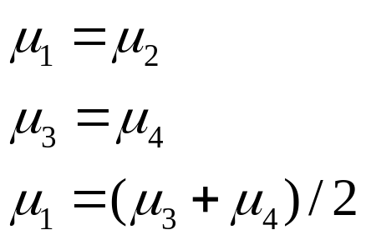
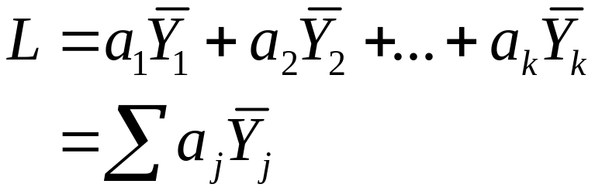
Linear contrasts
Pairwise comparisons of means are a special case of linear contrasts
Comparison of one group with another group with general weights
Linear contrasts take the form of a linear combination of the means

Slide 22
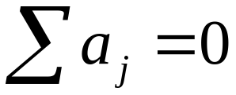
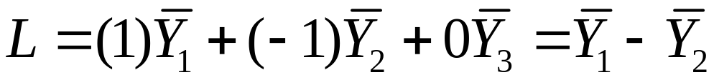
Linear contrasts
Restriction
Suppose we had three means and wanted to compare the first and the second only. This could be done by having a₁= 1, a₂= –1, and a₃= 0

Slide 23
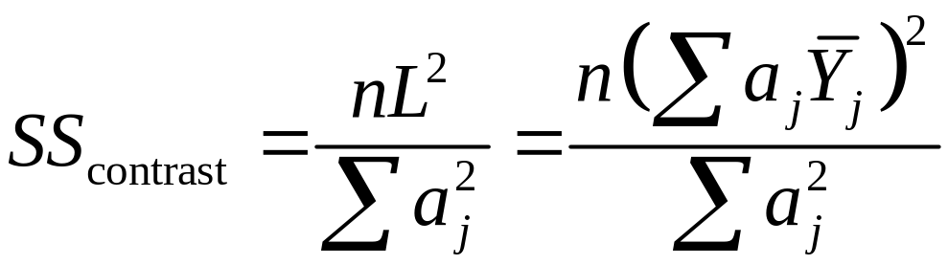
Linear contrasts
Linear contrasts allow us to express the sum of squared differences between the means of sets of treatments
Formula assumes equal sample sizes

Slide 24

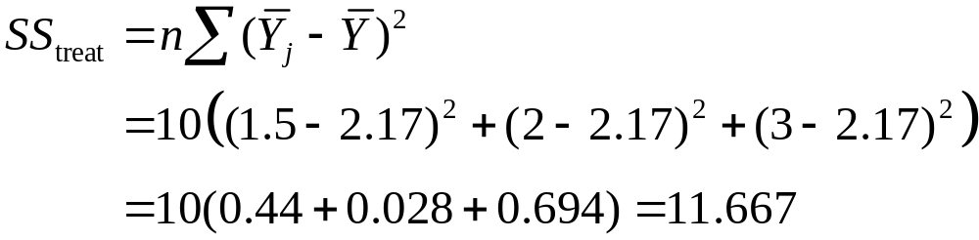

Example
Suppose we had
We can easily compute
Let’s say we wanted to compare the average of treatments 1 and 2 to treatment 3. Thus

Slide 25
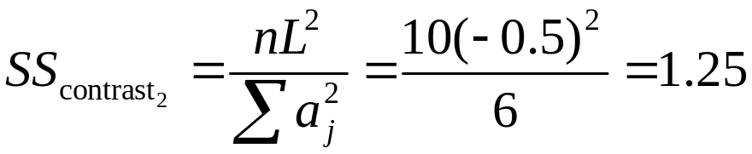
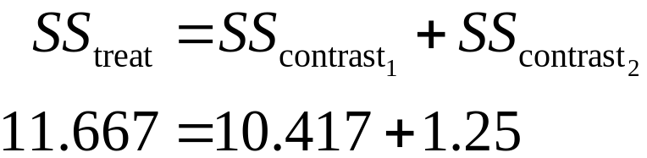
Example
Now suppose we wanted to compare groups 1 and 2:
Note that the sum of the two SS_{contrast} is
In this case, we can say that the contrasts completely partition SS_{treat}

Slide 26
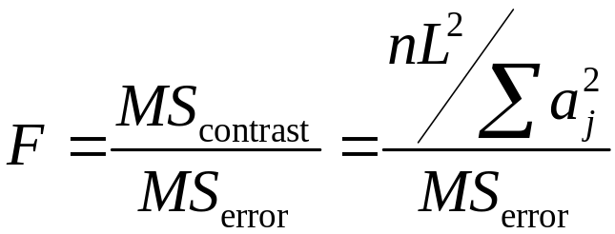
F test for contrast
Note that the absolute value of the contrast weights does not matter
Means: Y₁ Y₂ Y₃ Y₄ Y₅
a_{j}: 2 2 2 -3 -3
1 1 1 -1.5 -1.5
The significance of a contrast can be tested with an F test

Slide 27
Contrasts
The square root of the F for a simple contrast (a₁ = 1,a₂ = –1) is the same value obtained in a t test
  t tests are special cases of linear contrasts
Note however that if you run several contrasts, the familywise error will be much larger than α
  Bonferroni correction can be used
  Run fewer contrasts! Only as many as needed
  If they were really a priori, probably ok without correction

Slide 28
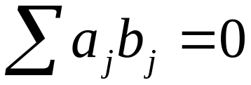
Orthogonal contrasts
Some contrasts are independent of one another, while others “share” information
Independent contrasts are called orthogonal
contrasts given by a_{j} and b_{j} are orthogonal

Slide 29
Orthogonal contrasts
It is useful to have orthogonal contrasts because they exactly partition SS_{treat}
However, it is not strictly necessary that all contrasts be orthogonal
  But remember that in this case the contrasts do not convey independent information

Slide 30
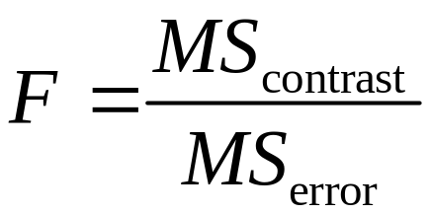
Degrees of freedom
For a contrast, we have
What are the numerator degrees of freedom?
Consider df for SS_{contrast}
A contrast always compares two quantities

Slide 31
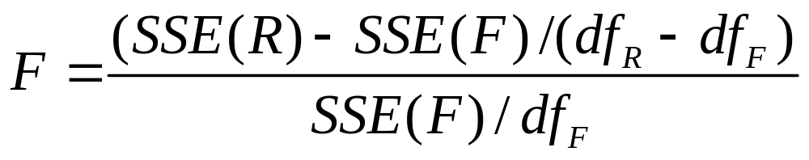
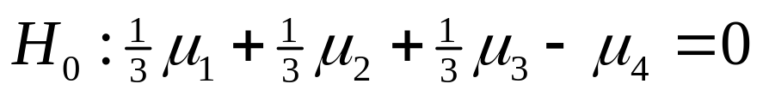
Degrees of freedom
Thus SS_{contrast} has df = 1
Another way to think of the df is that the F for a contrast can in fact be written in the usual way
To determine df_{R}, we must determine the number of independent parameters in the restricted model which is associated with the contrast
Consider the following null hypothesis:

Slide 32
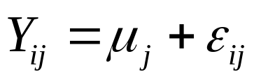
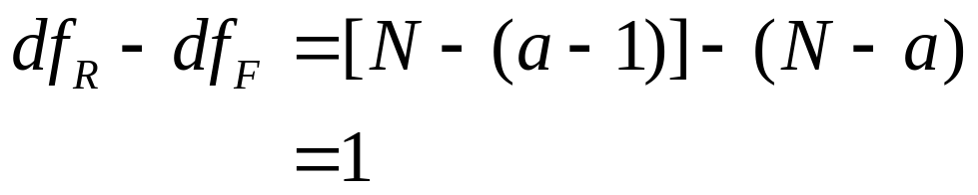
Degrees of freedom
The corresponding restricted model is
where 1/3μ₁+1/3μ₂ + 1/3μ₃ – μ₄ = 0
Model has 4 parameters but only 3 are independent
In the general case for a groups, we would have a – 1 independent parameters
Thus

